Slide 1
Web Development Issues
CMP 416-IB

Slide 2
objective
Study characteristics of web and its challenges

Slide 3
The Nature of Web Development Characteristics of Web Development
Research by Kappel et al (2004), seeks to answer the question.
The researcher suggested that web application development has four key characteristics:
software product itself,
its development,
its use and
its evolution.

Slide 4
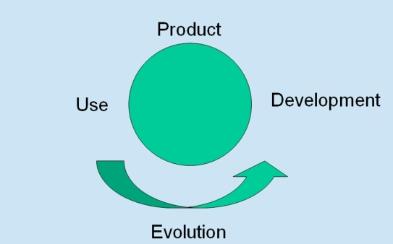
Web Application xteristics

Slide 5
Product characteristics
This relates to the software product itself and can be split into three components:
Content:
The Web is essentially content-driven - it started life as an information medium. The content may be structured (databases), semi-structured or unstructured (text-based and multi-media information). The content, however, is often dynamic and needs to be continually updated, and there is almost always a pressure to get the information to market very quickly. Web audiences, on the other hand, demand a high quality of content - they expect content to be accurate and up to date.
So we end up with a complex engineering problem, but one which also relies on high-quality content authors.

Slide 6
Hypertext
Hypertext is the fundamental language of the Web. It provides for a new way of structuring information,
and new ways of accessing information.
This brings its own problems: whereas a book generally provides a linear presentation of information (it starts at the beginning and ideas are presented one after the other), the websites allow a completely non-linear approach, where users can browse for, search for and click on whatever they want, in any order. This can lead to problems of disorientation ("where am I?") and cognitive overload ("too much
information!").

Slide 7
Presentation
Presentation - look and feel - is key to web applications. Conventional software systems often have a standardized approach to the presentation of the material. Web designs allow more freedom in
presentation, but they are subject to pressure for frequent changes from users, in keeping with current
trends and fashions.

Slide 8
Usage Characteristics
How the web application is used can also be split into three components
Context
Where and how users access web application varies widely and cannot be predicted - users often choose the time and location to suit themselves. This is increased with the rise of mobile computing.
They demand immediate and permanent availability: 24 hours a day, 7 days a week.

Slide 9
Technical infrastructure
The actual hardware and software systems being used to access the web are unpredictable - there is a multitude of end-user devices (PCs, Macs, mobile devices and more), running a multitude of software -operating systems, browsers and more. The network system being used for access, its type, speed, reliability, is another variable. All these combine to affect the quality of service.
And then, the final representation of the web application - how the user actually looks at the application - is outside the developer's control, because users may choose not to display certain components, such as pictures,. They may also override style settings to suit their own preference

Slide 10
Diversity and magnitude of users
There are many different types of users - for instance in ability, experience, culture and age. Numbers are also unpredictable - will the application work as well with a large number of users as it does with a small number?
Note that Users will only use the system if it delivers what they want, how they want it, and when they want it.

Slide 11
Development Characteristics
The way the application is developed can again be split into three dimensions:
Development team
The people contributing to the development have an effect on it - the team must be multi-disciplinary -involving not just programmers and analysts, but authors, publishers, designers and marketers. Team members are often younger than conventional teams - they are often less willing to stick to conventions and more inclined to apply new, immature technologies. There is also often involvement of open source communities.

Slide 12
Development environment
The technical infrastructure is very varied and volatile, with constant changes. Because of time-to market pressures, the infrastructure components often immature, and lack stability, reliability and even the desired functionality. There may also be the need to integrate into legacy systems, which may not be well-documented or supported.

Slide 13
Development Process
This is characterized by frequent changes and adjustments, caused by rapid technological developments, fast changing trends, volatile requirements, against short and rigid schedules.

Slide 14
Evolution Characteristics
Traditionally, software development methodologies have taken an approach which sets down the requirements of the system - how it will work and what it will do - at the start and builds to that specification. The product is then put into live operation, where it is maintained, and altered only to correct errors and to add enhancements.
How the product will change in the future is not usually considered in traditional software development -however, it is emerging as an extremely important aspect of web application development

Slide 15
Web applications typically require frequent changes andare usually in a state of permanent evolution.
This is driven both by changing technology.

Slide 16
Lets refer back to our question.
It is clear that web developers
Web developers can clearly learn from the mistakes and solutions of earlier developers, but web
applications also have some specific characteristics not found in conventional system
Just as software engineering emerged as a discipline in its own right for conventional software systems, so Web engineering is emerging as a separate discipline, with its own tools and procedures

Slide 17
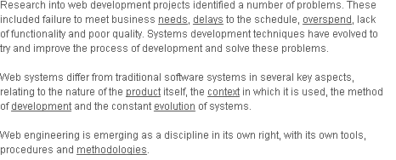
Final note

